Slide 1
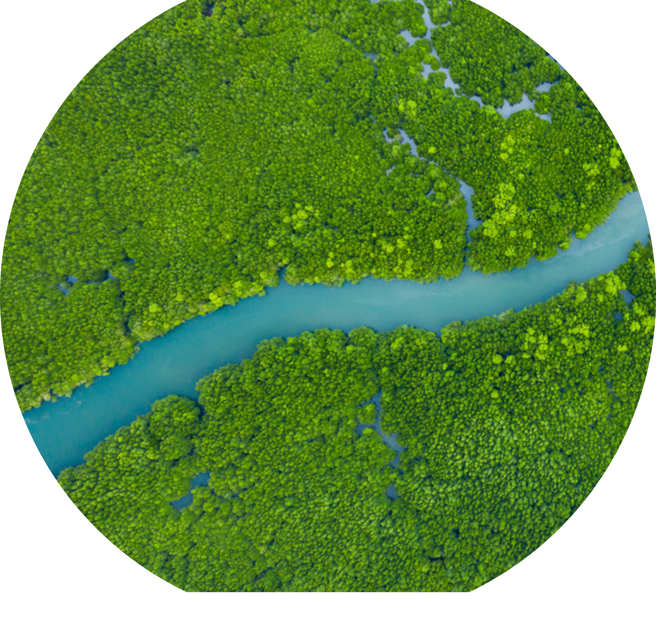
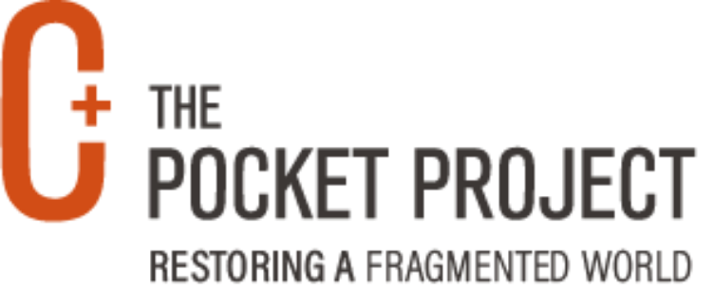
THE POCKET PROJECT
Restoring a Fragmented World

Slide 2
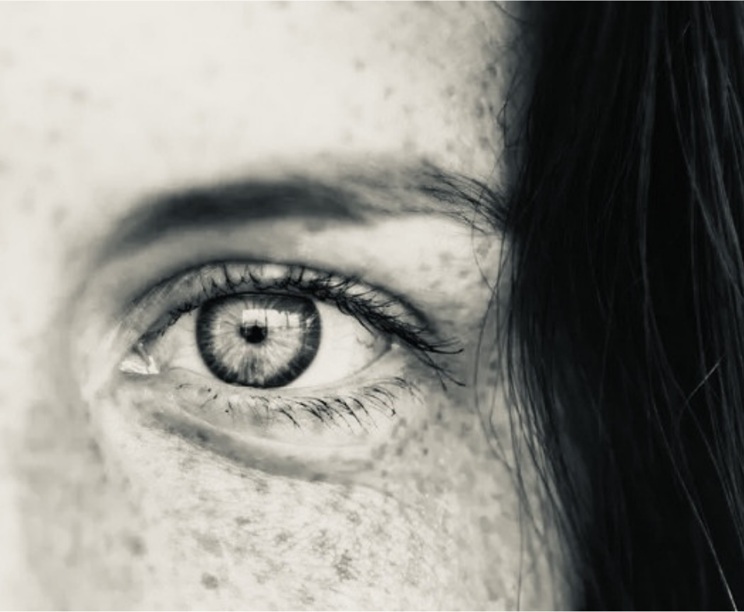
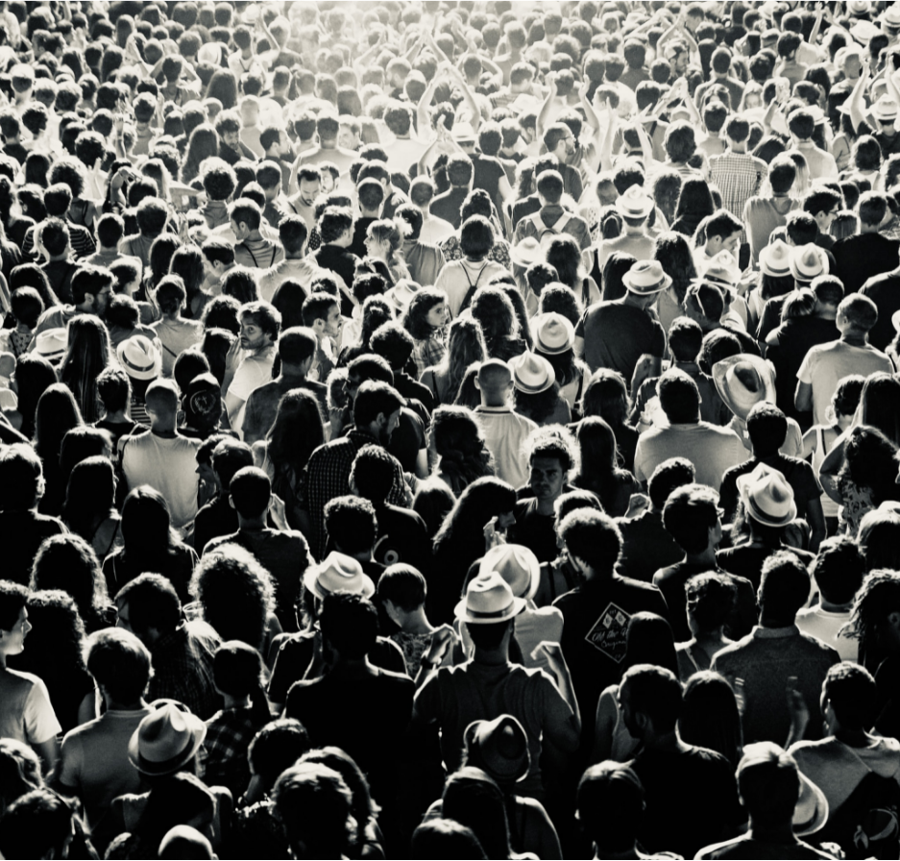
OUR VISION:
OUR MISSION:
We inspire trauma-informed awareness, and contribute to the healing of collective trauma, thus reducing its disruptive effects on our global culture. We induce a shift from trauma-inducing to trauma-informed and trauma-integrating institutions and societies.
We restore fragmentation by addressing and integrating individual, ancestral and collective trauma. We heal wounds from the past, thus shifting humanity towards a path of collaboration, innovation and emergence.

Slide 3
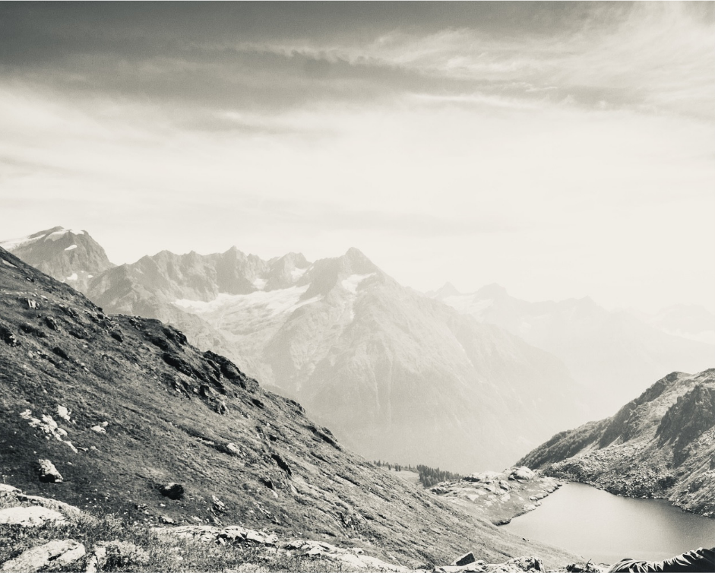
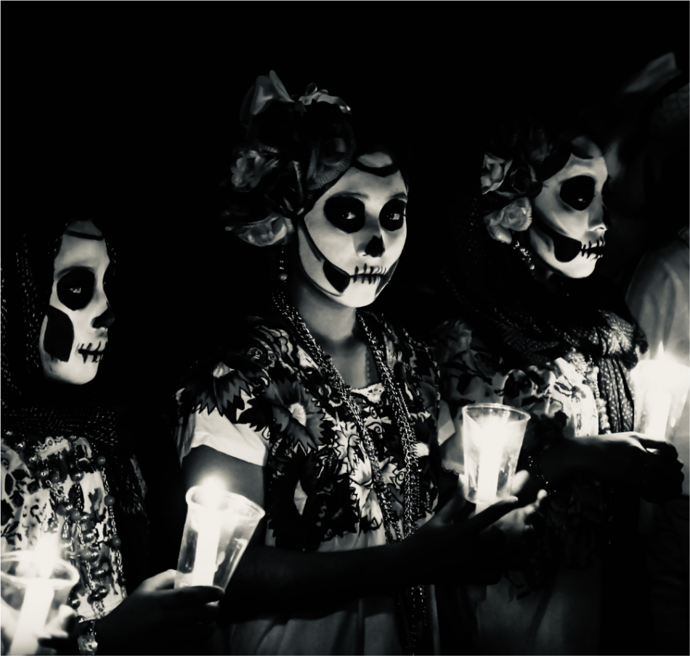
OUR THEORY OF CHANGE:
We cultivate presence, relational sensing and coherence in individuals and groups. Once a certain level of synchronisation and resourcing is reached, we can turn our witnessing presence consciously towards trauma contents and allow information to naturally arise. When trauma contents are touched upon, so are our protective layers of denial and resistance. Our we-spaces need to be resourced and coherent enough to be able to provide a hosting space of witnessing presence for what arises. Then, we can begin to acknowledge and digest what could not be processed before. The ensuing integration and restoration leads to a decrease in isolation and polarization and an increase in compassionate and collaborative ability. Our creative and innovative potential can flow more easily into the world.

Slide 4
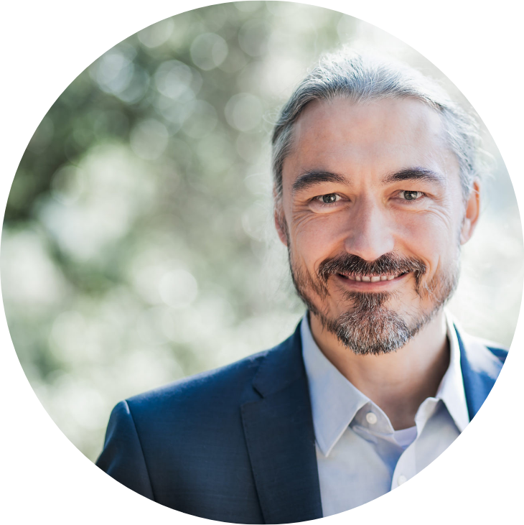
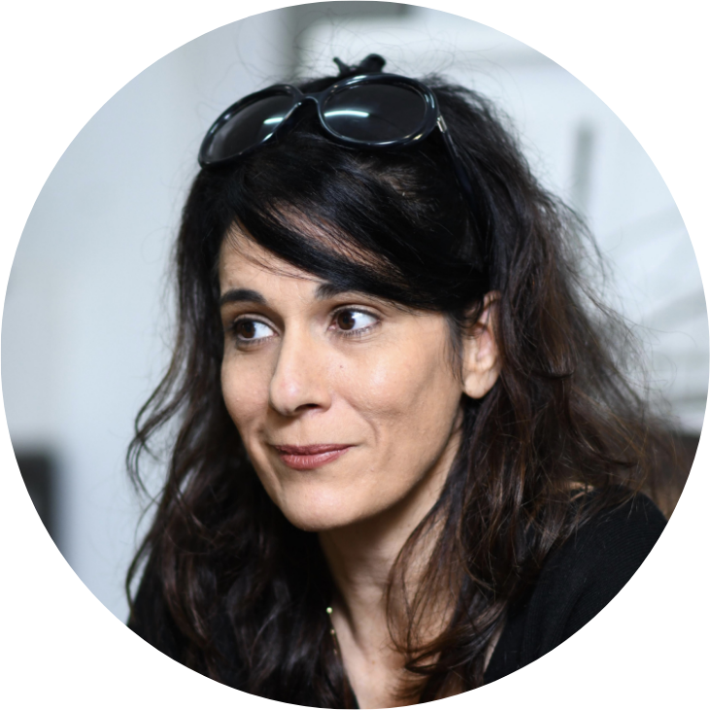
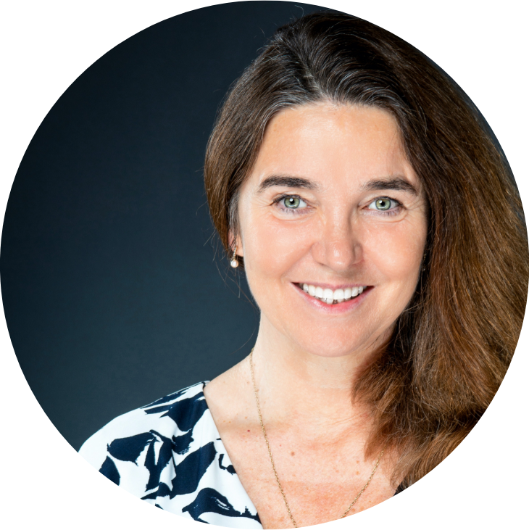
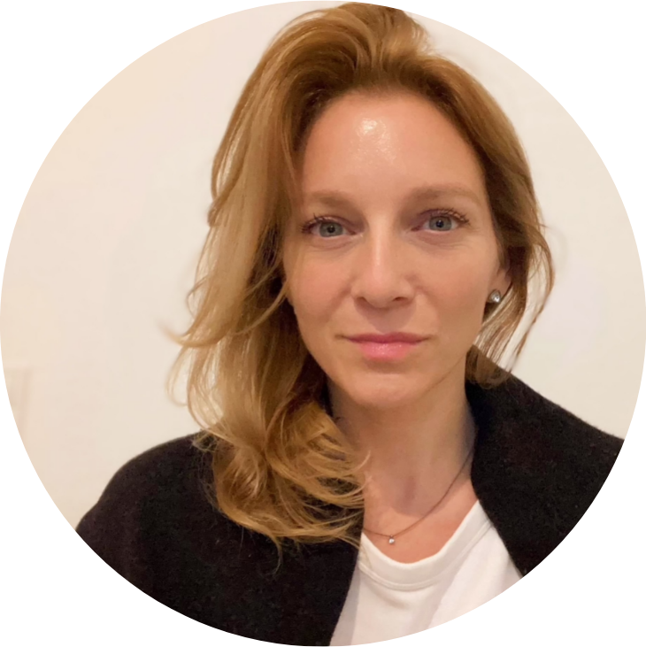
OUR CORE TEAM:
THOMAS HUEBL
YEHUDIT SASPORTAS
KOSHA JOUBERT
ANNE VOLLBORN
CHAIR & CO-FOUNDER
CO-FOUNDER
CEO
PROJECT MANAGER

Slide 5
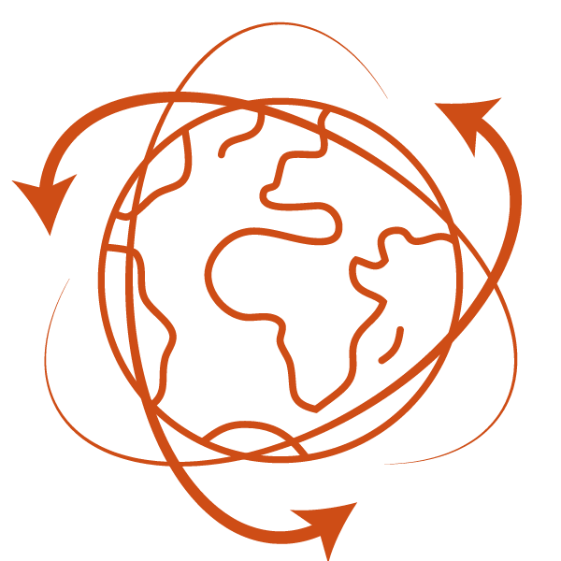
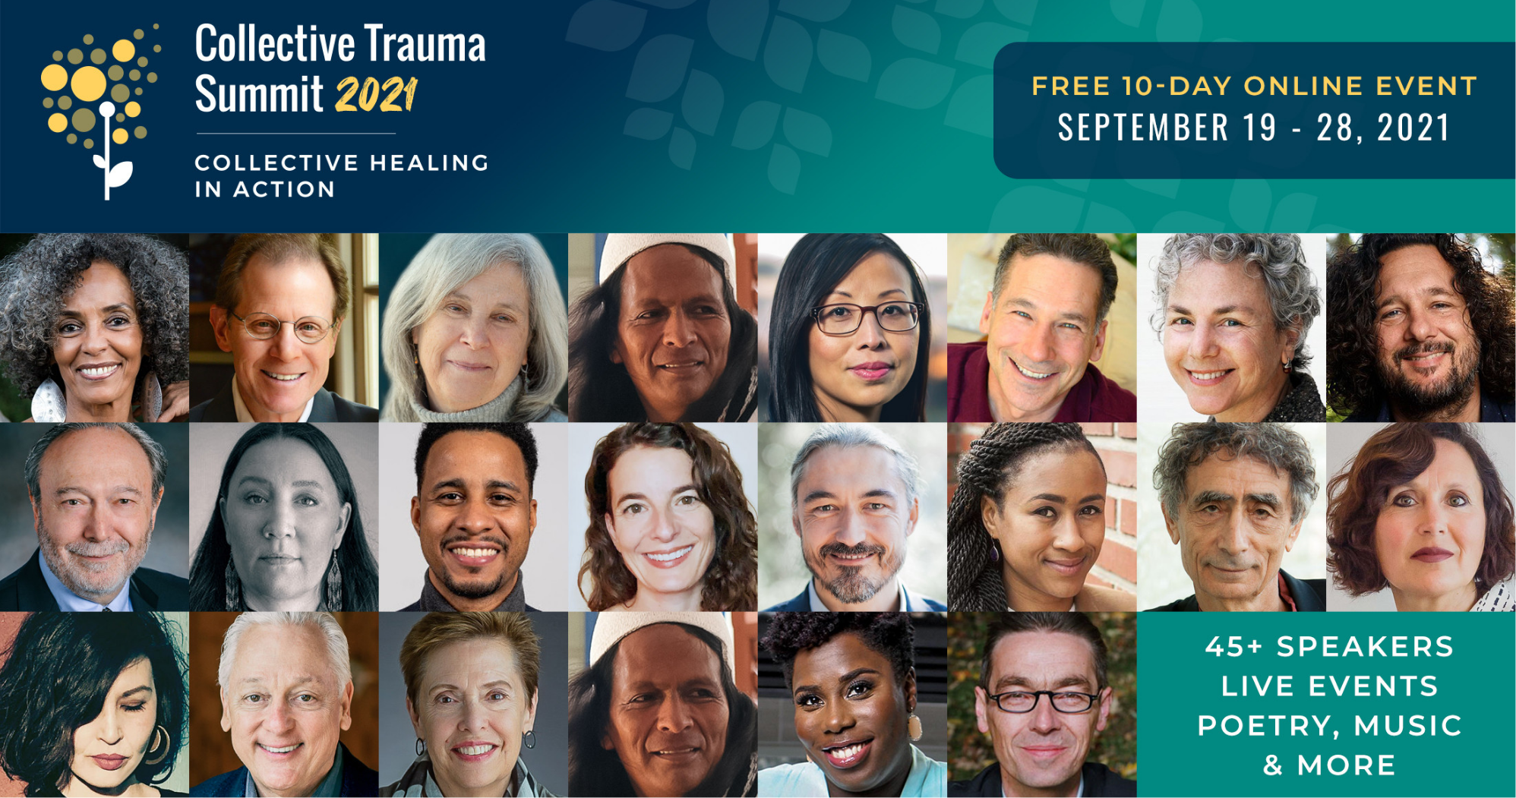
1. INSPIRE – PARTNER TO THE ONLINE SUMMIT
We reach out to a broad audience to inspire awareness on the global impact of collective trauma and possibilities for collective trauma healing through social media, festivals and online summits
The third Collective Trauma Summit will be hosted from 19 Sept to 29 Sept 2021 with inspiring talks from leading psychotherapists, neuroscientists, indigenous wisdom keepers, biologists, artists, and social activists. During this 10-day global event, we aim to create a powerful container to share awareness , while providing key action steps you can take to be part of the solution.
Participants in 2020 108.000

Slide 6
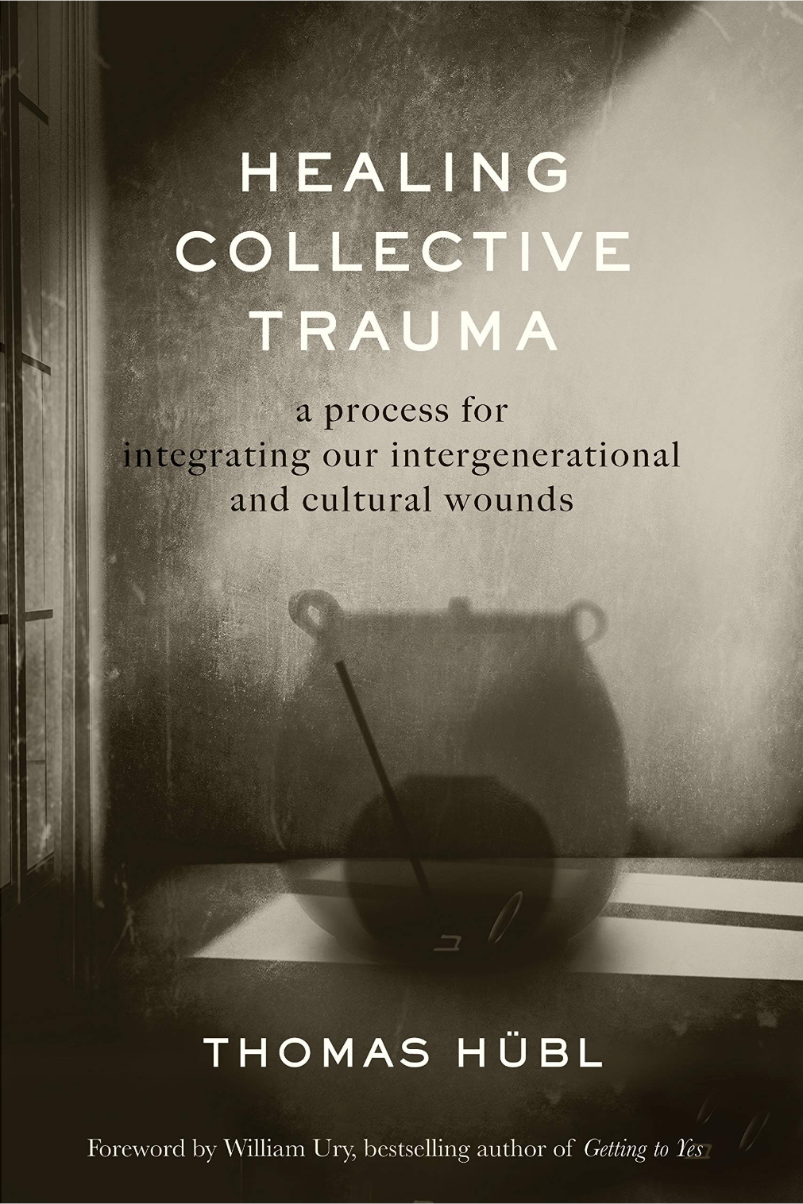
1. INSPIRE - BOOK ON COLLECTIVE TRAUMA
SOCIAL MEDIA OUTREACH
PP 5.750 PP Field 91.769
HEALING COLLECTIVE TRAUMA –
a process for integrating our intergenerational and cultural wounds
Thomas Hübl's book (2020) provides a comprehensive guide to understanding and healing trauma that is shared among communities and transmitted over generations.
NEWSLETTER
PP 7.285 PP Field 162.100
Translated into English, German and Dutch Being translated into Spanish, Finnish, Korean, Croatian

Slide 7
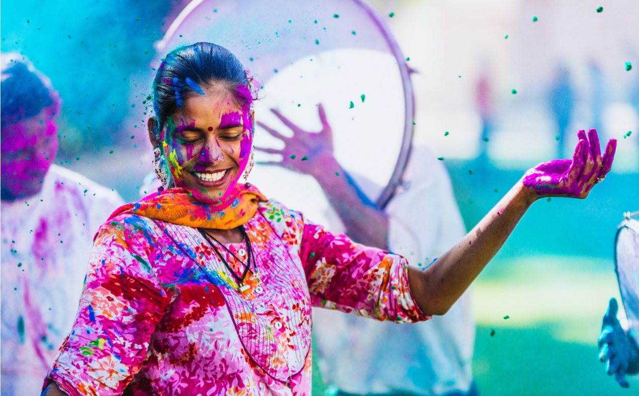
2. ENGAGE - SCHOLARSHIP PROJECT
We offer scholarships for participants from diverse cultural backgrounds and the Global South.
"We in Afghanistan feel numbness and detached from our selves and our emotions so these meditations help us to be in touch with our inner true self."
Spozhmay Oriya, Assistant Professor, Kabul University, Afghanistan
In 2020, we allocated 214 packages for the Collective Trauma Online Summit and 73 places on the Principles of Collective Healing Course.
In 2021, we allocated 68 places on the Trauma-Informed leadership Course.
Collective trauma integration prepares the ground for the emergence of healing institutions and evolutionary development in our societies. Our aim is to offer access to information and skills to as many people from diverse cultural backgrounds and the Global South as possible. We allocate scholarships to multipliers who will have impact within their communities.
Recipients 382 Amount €72.898

Slide 8
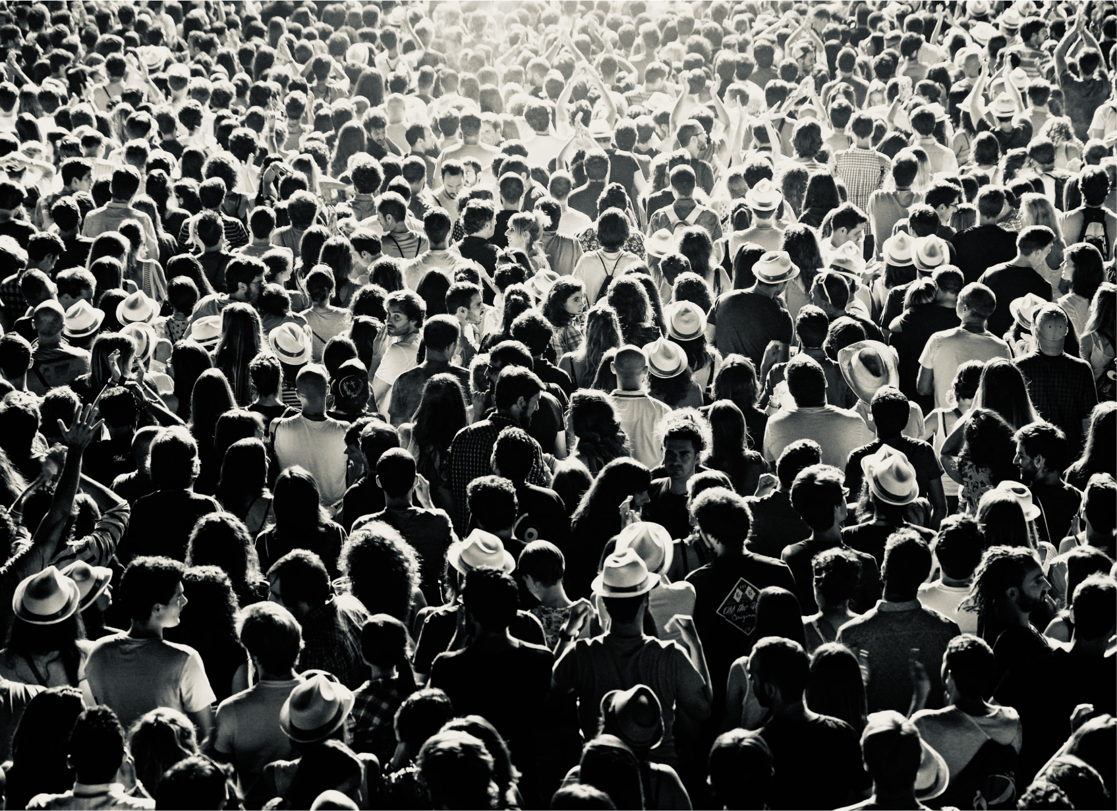
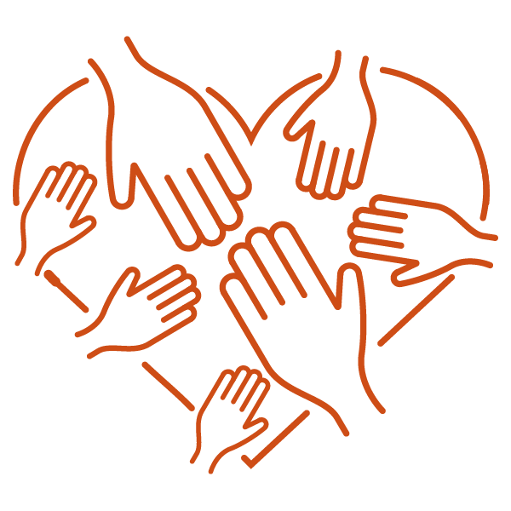
2. ENGAGE - COMMUNITY CALLS
We create opportunities for engagement and collective competence building to both civil society and professionals.
We offer public calls for both trauma integration and trauma prevention.
RELATEDNESS AND COMPASSION
Our relations are an essential part of who we are – and we can consciously cultivate this aspect in our lives, even and especially during times of crisis. The Pocket Project is committed to develop spaces for collective learning of skills for relatedness and compassion. We need these skills to activate the healthy response mechanisms of our global immune system.
Participants since March 2020 1065

Slide 9
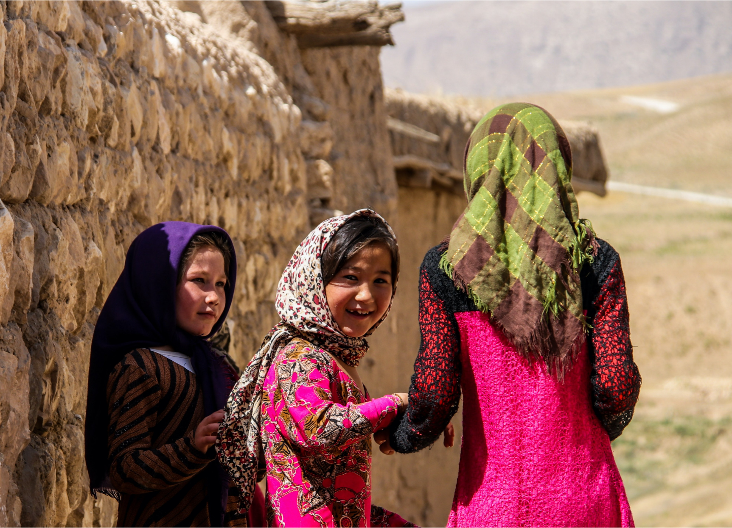
2. ENGAGE - GLOBAL SOCIAL WITNESSING
Join us for our next free call on Monday, 8 November
Collective Trauma & Climate Change
BE PRESENT - FEEL WHAT YOU SEE - BECOME A GLOBAL SOCIAL WITNESS
Global Social Witnessing teaches us to gently turn our attention towards rather than away from challenging information. We mindfully attend to global events with an embodied awareness, thereby creating an inner world space that mirrors and brings compassion to these events.
Participants since March 2020 1272

Slide 10
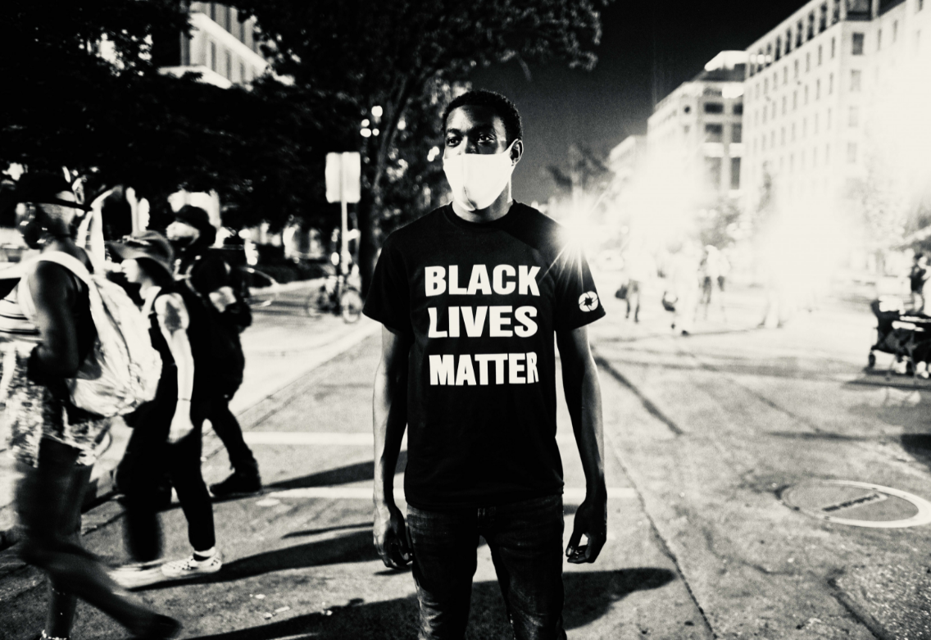
3.WITNESS - INTERNATIONAL LABS
Initiate International Labs that convene geographically and thematically specific groups to address collective trauma and initiate a restoration process for respective countries or topics.
The Labs started with a 9-month cycle from November 2020 to June 2021.
We are currently in a period of reflection, digestion and integration, teasing out and publishing our meta-learnings.
A second cycle of the International Labs will start in 2022, continuing and deepening the journey for those Labs already established and expanding to include more topics and countries.
The International Labs convene geographically and thematically specific groups that meet with the support of trained Pocket Project facilitators over several months to explore the history, expression and possibilities for restoration of specific thematic or localised fields of collective trauma.
Labs 23 PP Facilitators 42 PP Trainees 48 Participants 692

Slide 11
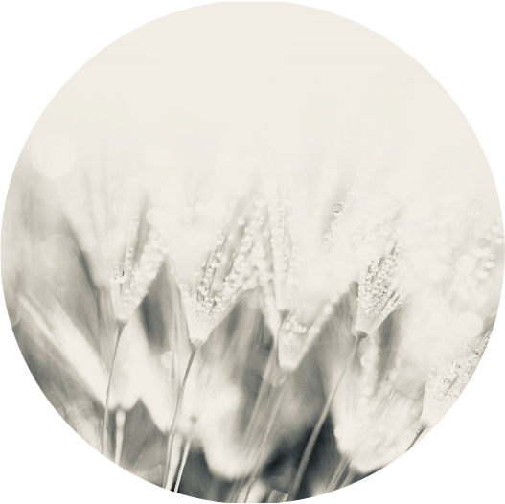
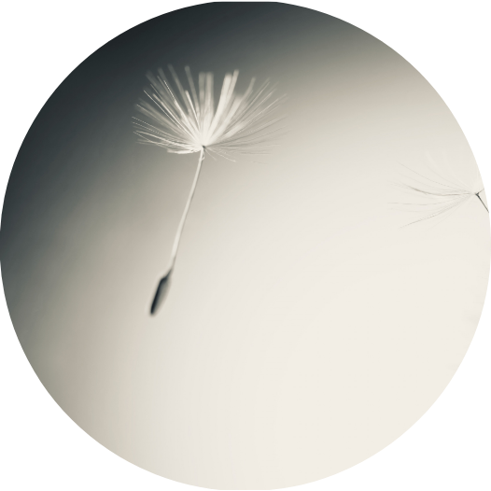
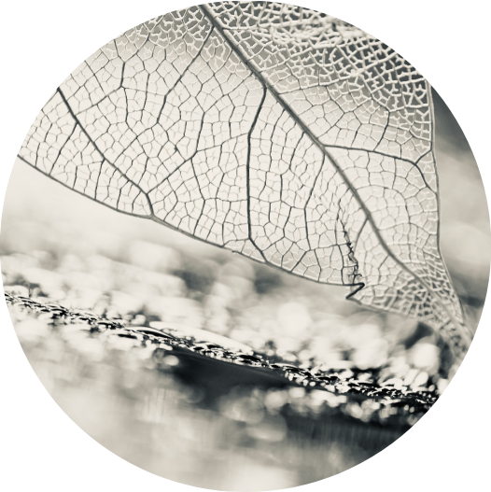
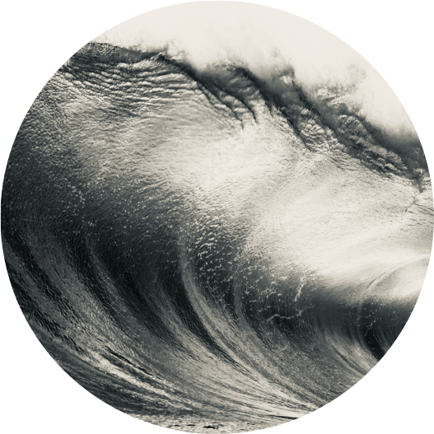
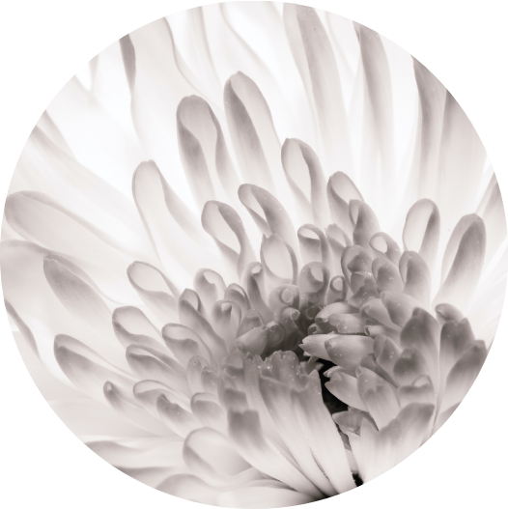
COLLECTIVE TRAUMA INTEGRATION - STAGES
Synchronising & Resourcing
Meeting the Collective Trauma Landscape
Exploring Individual & Collective Conditioning
Listening to Voices
from the Field
Integration and Reflection
Transforming &
Meta-learning
FORMING RELATIONAL COHERENCE AS A GROUP. ACCESSING INNER AND OUTER SOURCES OF RESILIENCE.
PRACTISING FOUNDATIONAL SKILLS.
EXPLORING THE HISTORICAL BACKGROUND AND ACKNOWLEDGING DISCREPANCIES IN INFORMATION. ACCESSING DENIAL OR REPRESSION OF THE TRAUMA.
MEETING THE ENERGY LANDSCAPE.
HOW AM I AFFECTED BY THIS FIELD OF TRAUMA? HOW DOES IT SHAPE OUR CULTURE AND SOCIETAL INSTITUTIONS? BECOMING A CONDUIT OF THE PAST, TO BE VOICED, EXPRESSED AND WITNESSED.
TRACKING THE SPECIFICITY OF INDIVIDUAL AND COLLECTIVE VOICES THAT ARISE. CONNECTING TO ANCESTRAL ROOTS. CLOSING IN ON THE ETHICAL VIOLATION THAT TOOK PLACE. AWARENESS OF HOW SACRED LAW WAS CROSSED.
RETURNING TO SYNCHRONISING BODY, EMOTIONS, MIND AND SPIRIT TO BEGIN INTEGRATION. WHEN THERE IS STILL TOO MUCH TRAUMA CAPTURED IN THE PERMAFROST, RESTORATION REMAINS A CONCEPT.
WHAT STEPS ARE NEEDED TO ALLOW FOR RESTORATION? MIGHT THERE BE CONCRETE STEPS ARISING FROM OUR JOURNEY TOGETHER?
WE ARE RESTORING THE FLOW OF LIGHT IN THE FABRIC OF LIFE.

Slide 12
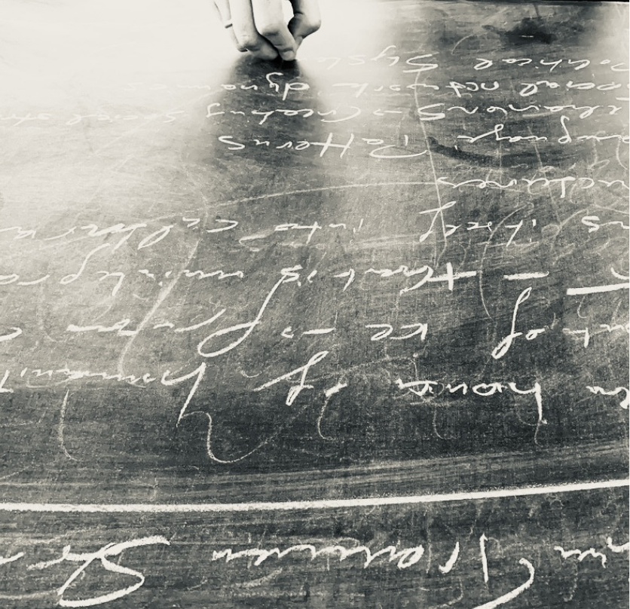
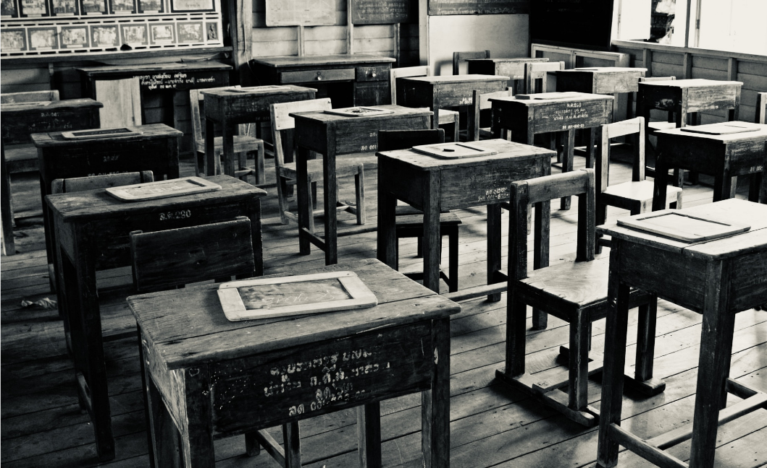
4. LEARN - META LEARNING FRAMEWORK
We provide access to the outcomes of our learning and research in our Study Room and Resource Library. We are building circles of contributing experts, researchers and PP facilitators.
"I loved how the arc of our experience in our course community of 1,500 participants made it possible for me to understand how overwhelm and numbness shows up in the collective."
Naser Al S. - Artist,
United Arab Emirates
RESEARCH
We are working with surveys to elicit information from our CTIP and LAB teams and participants. Our central research questions is:
‘Can coherent we-spaces and a process of witnessing collective and intergenerational trauma lead to an integration and eventual healing of collective trauma?’
Surveys 56
Responses 2.820

Slide 13
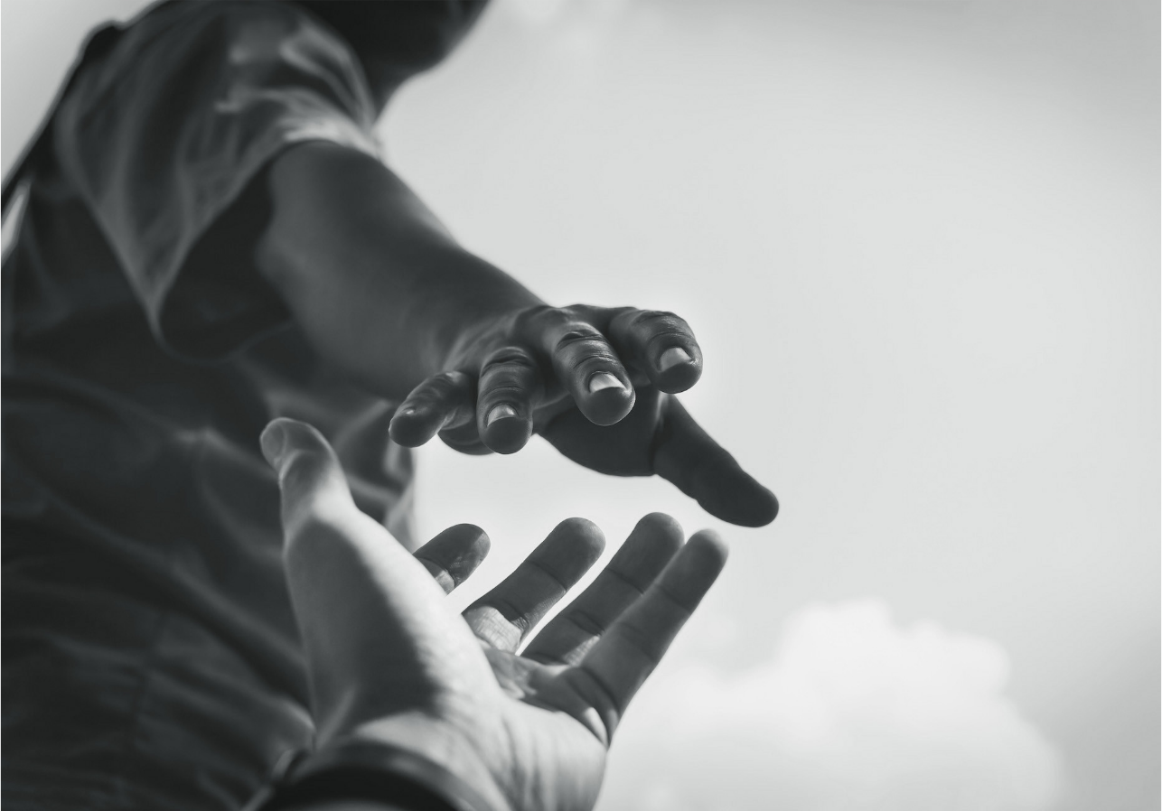
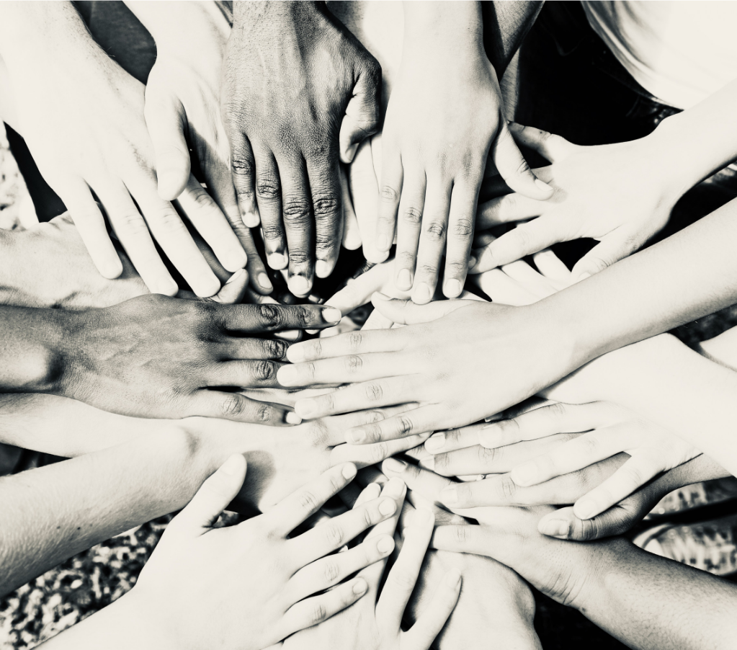
5. APPLY - TRAUMA-INFORMED LEADERSHIP
We offer training on trauma-informed leadership to NGOs and Global Aid Organisations.
PP EDUCATION
Crystallised knowledge is being transformed into trainings which can be offered to NGO’s, global aid organisations, health workers, etc. We consult organisations to integrate trauma-informed practices and policies.
We live in the effects of the shadow of karma coming up through our roots from the past. In our work we loosen it up in a resourced way to open the nervous system to become more fully responsive again.
As leaders, we are called to raise our awareness of the multifaceted nature of trauma and understand its impact on us, our teams, and our work in the world.
Participants 370 Countries 64

Slide 14
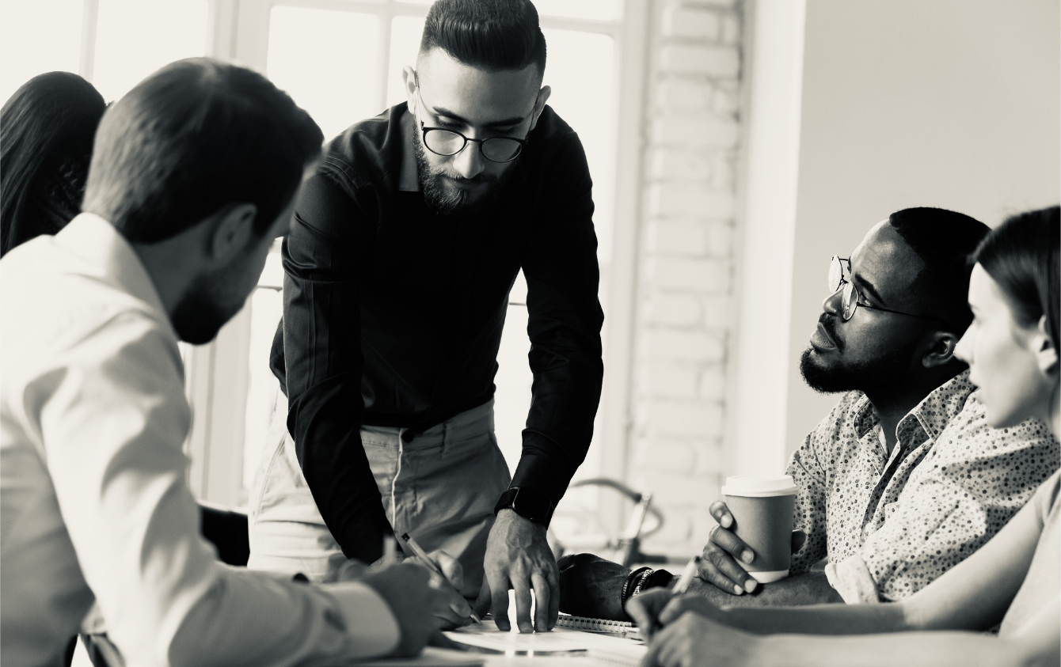
5. APPLY - COMPETENCE CENTERS
We are setting up Competence Centres for the further refinement and application of knowledge on Collective Trauma Integration to specific sectors.
COMPETENCE CENTERS
PP
CONSULTANCY
The meta-learning that takes place throughout the Pocket Project is applied to specific sectors:
We support NGO's and Aid Organisations to understand the larger cultural and historical dynamics of collective resilience and trauma which they are working within and become trauma-informed and trauma-integrating.
Global Social Witnessing
Restorative Justice
The Healing Professions
Climate Change & Trauma
Racialised Trauma
Women & Gender-based Trauma
Trauma-informed Leadership
Relational Competence
Collective trauma integration initiatives are like global acupuncture - the newly released energy transforms us, liberating our creative potential by feeding radical new solutions and rapid innovation.

Slide 15
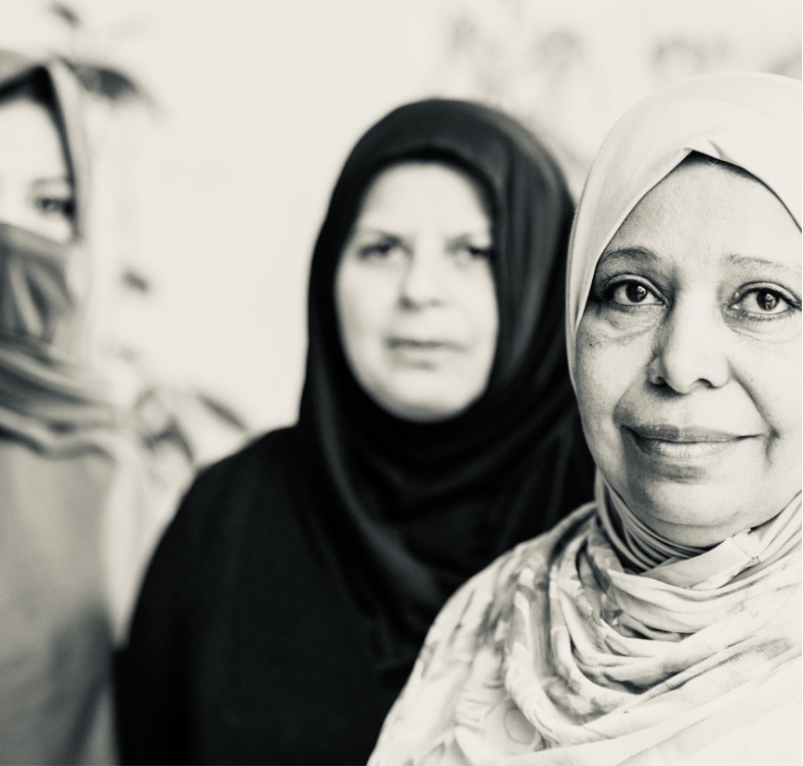
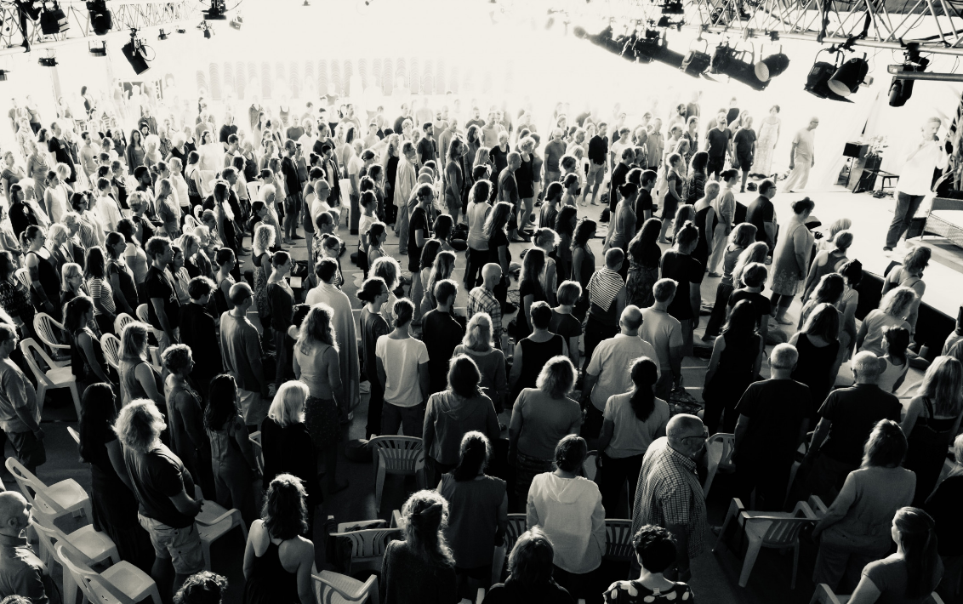
6. INTEGRATE - CTIP
We are setting up Collective Trauma Integration Processes for organisations or countries in partnership
with leadership circles and governing bodies.
COLLECTIVE TRAUMA INTEGRATION PROCESS
Collective trauma integration initiatives are like global acupuncture - the newly released energy transforms us, liberating our creative potential by feeding radical new solutions and rapid innovation.
We are currently working with specific countries and universities to use Collective Trauma Integration Processes in order to heal polarisation and work towards democratisation and violence prevention e.g., in Boulder/Colorado and Germany.
Trauma exists as an interruption of our true condition, but connectedness, true intimacy and love belong to us by birthright.

Slide 16
7. PARTNER – PRESENCE AT UN COP26
Cultivate generative international partnerships with like-minded organizations and prepare for consultative status at the UN.
PP @ COP26
Our team will be present at 26th UN Climate Change Conference in Glasgow, bringing in the themes of:
Collective trauma and its impact on both burn-out and apathy in response to Climate Change
Trauma-informed leadership and its importance in allowing for more effective Climate Change action
Global Social Witnessing as a collective tool that allows us to relate to Climate Change
Collective Healing in Action
Trauma-Informed Leadership & Climate Change
Trauma is at the root of our inaction in the face of Climate Change. Trauma symptoms of apathy and hyper-activation dramatically slow down our ability to respond adequately. Our lack of relationship to the crisis is part of the crisis. The Pocket Project aims to restore our collective ability to relate sensitively and compassionately thus opening up to an increased flow of information and possibility.
Join us from 1-12 November for live conversations, interviews, witnessing and shared meditation, with Thomas Huebl and many others.

Slide 17
If everybody looks through broken glass, then together, we are looking at a world that looks broken. When I notice my crack in my window, and you notice yours, and we start healing our cracks, then we begin to look at the world through clear glass. And that’s what trauma healing does. It starts unifying the world.
Thomas Hübl

Slide 18
Thank you!
https://pocketproject.org/

